Slide 1


SQL Hosting
If you want your web site to be able to store and retrieve data from a database, your web server should have access to a database-system that uses the SQL language.
The most common SQL hosting databases are MS SQL Server, Oracle, MySQL, and MS Access.
Microsoft's SQL Server is a popular database software for database-driven web sites with high traffic.
SQL Server is a very powerful, robust and full featured SQL database system.
Oracle is also a popular database software for database-driven web sites with high traffic.
Oracle is a very powerful, robust and full featured SQL database system.

Slide 2
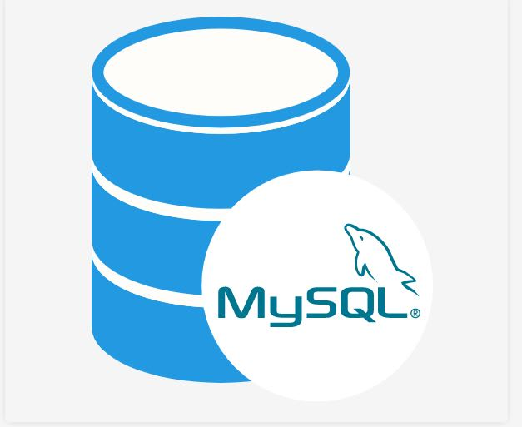

SQL Hosting
MySQL is a popular database software for web sites.
MySQL is a very powerful, robust and full featured SQL database system.
MySQL is an inexpensive alternative to the expensive Microsoft and Oracle solutions.
When a web site requires only a simple database, Microsoft Access can be a solution.
Access is not well suited for very high-traffic, and not as powerful as MySQL, SQL Server, or Oracle.

